Slide 1
Exploring the Links Between Diseases and the Human Microbiome
By Jacqueline Daniel, Amanda Bell, Vivek Kanpa, and Zoe Morris
Notes:
Jackie

Slide 2
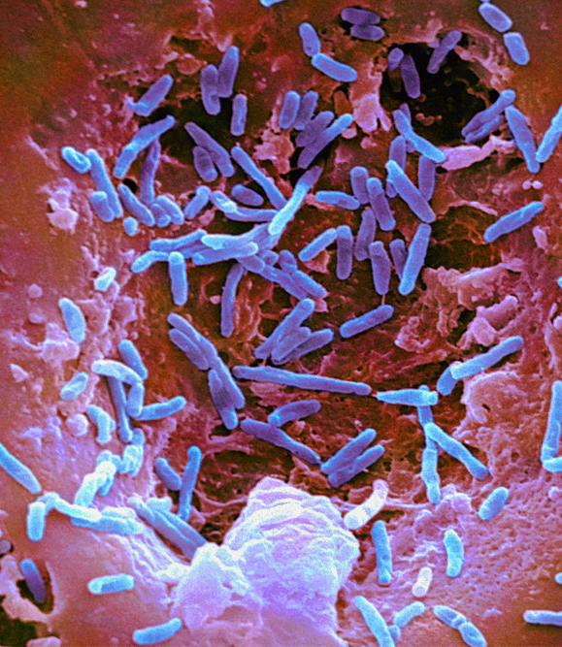
PROJECT IMPORTANCE
Our microbiome plays a large role in our health
Well known and understood roles:
Digestion
Immunity
Lesser known and understood roles:
Neurotransmitter production
Micro-protein production
Health regulation
Understanding how bacteria levels and diversity in our microbiome can inform treatment on many diseases and show novel connections
Notes:
jackie

Slide 3
OUR QUESTIONS:
What are the diseases that are highly associated with bacteria?
Which bacterium is linked to the greatest number of diseases?
Are there diseases that are linked to covid-19 through a type of bacteria?
Which bacteria are linked to diabetes ?
Are there common bacteria among the different types of diabetes?
What diseases are associated with bacteria linked to cancer?
Which bacteria are linked to neurodegenerative diseases?
Alzheimer’s Disease, Parkinson’s Disease, ALS
Notes:
Vivek

Slide 4
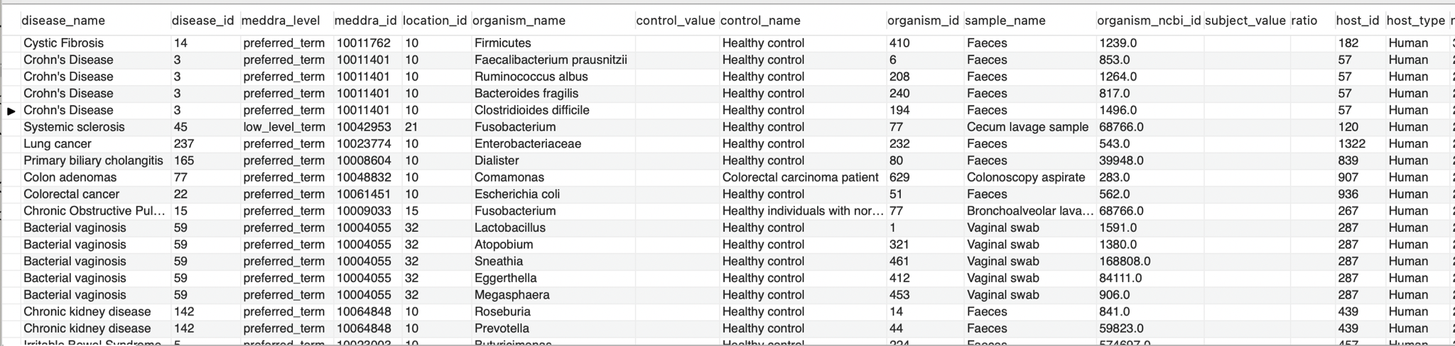
THE DATASET
Disbiome Database
Rows:
Represent a publication
Columns:
Disease name, organism name,
qualitative outcome, sample type
Notes:
Jackie

Slide 5
Data Representation
Organism:
Organism_id
Organism_name
Location_id
Associated:
Num_pubs
Qualitative_outcome
Disease:
Disease_id
Disease _name
Host:
Host_Id
Host_type
Notes:
Jackie

Slide 6
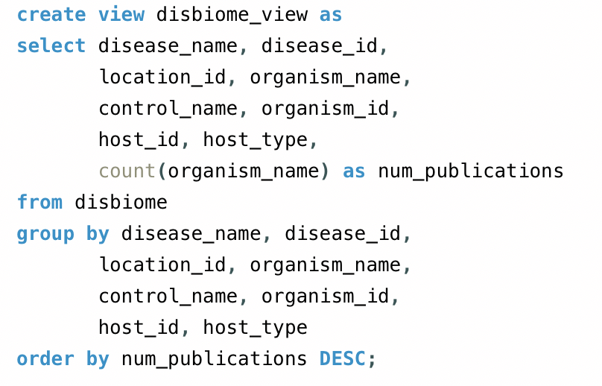
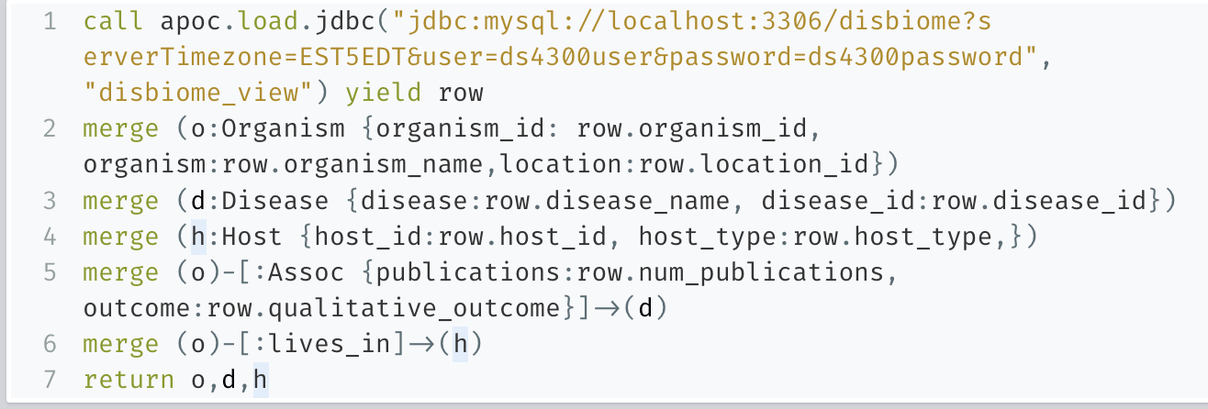
PRELIMINARY SQL AND NEO4J QUERIES:
Notes:
Jackie

Slide 7

Graph:
Nodes:
Yellow: Disease
Red: Organism/Bacteria
Pink: Host
Relationships:
A bacteria is associated with a Disease
A bacteria lives in a host
6,414 nodes, 20,234 relationships
Notes:
Zoe

Slide 8
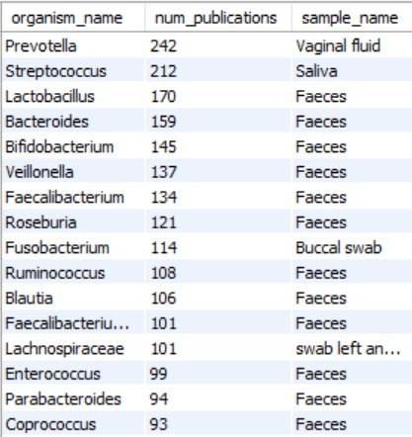
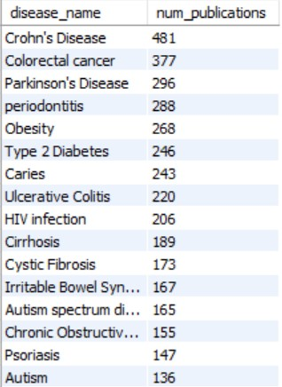
Which bacteria are most associated with diseases?
Which diseases have been studied most with regards to bacteria?
Notes:
Amanda
Prevotella - respiratory tract but naturally part of oral and gut microbiome
Streptococcus - strep throat, pneumonia, pink eye, some species also naturally part of human microbiota
Lactobacillus - healthy bacteria in gut and fermented foods
Bacteroides , Bifidobacterium, veillonella, faecalbacterium, roseburia, ruminococcus, blautia, lachnospiracaea, parabacteroides, coprococcus - gut bacteria
Fusobacterium - periodontics, skin ulcers
Enterococcus - uti, meningitis
Crohn’s disease is inflammatory bowel disease, colorectal cancer involving part of digestive system
Periodontitis - gum infection, caries - tooth decay
GI dysfunction is a common symptom with Parkinson’s Disease
Studies suggest that obesity is associated with low microbiome diversity
Obesity associated with diabetes so that makes sense
Unbalanced gut bacteria lead to type 2 diabetes
HIV - damaged immune system so you’re exposed to lots of different bacteria
Cystic fibrosis - more susceptible to lung bacterial infection

Slide 9
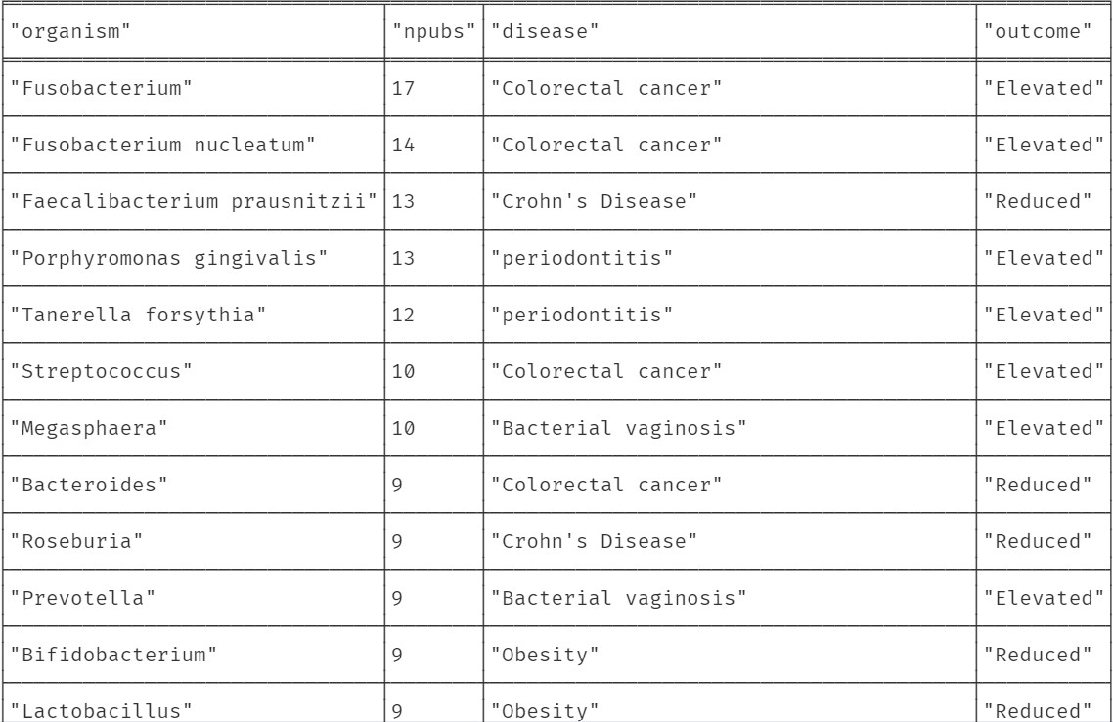
Which diseases are most linked to specific gut bacteria?
match (o:Organism)-[a:Assoc]->(d:Disease)
where a.publications > 5
return o.organism as organism, sum(a.publications) as npubs, d.disease as disease, a.outcome as outcome
order by npubs desc
Notes:
Amanda

Slide 10
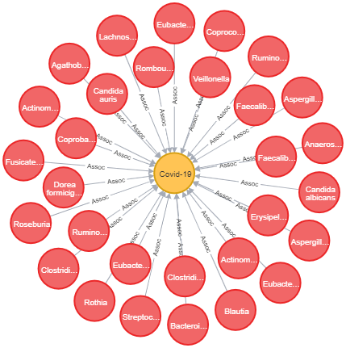

Which bacteria are linked to Covid-19?
match (o:Organism)-[a:Assoc]->(d:Disease {disease:"Covid-19"})
return o, a, d
30 nodes, 31 relationships
Notes:
Zoe

Slide 11
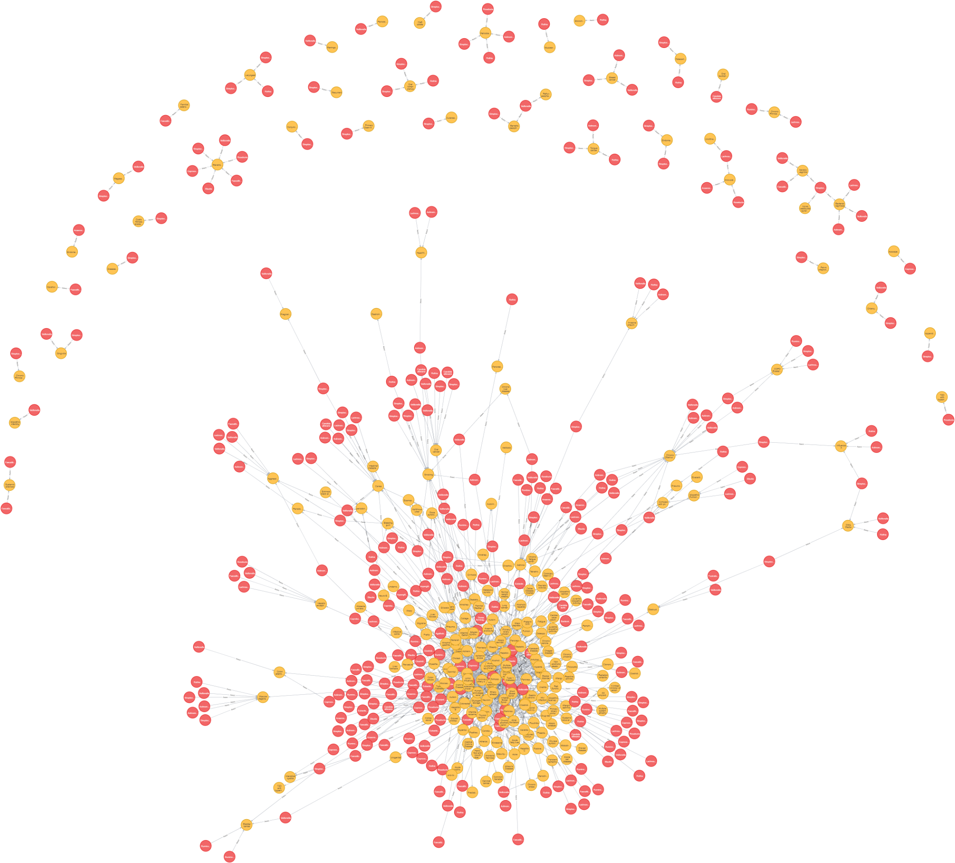

What diseases are associated
with bacteria linked to
Covid-19?
call {
match (o:Organism)-[a:Assoc]->(d:Disease {disease:"Covid-19"})
return collect(o.organism) as bacteria
}
match (o:Organism)-[a:Assoc]->(d:Disease)
where o.organism in bacteria
return o, a, d
558 nodes, 1,135 relationships
Notes:
Zoe

Slide 12
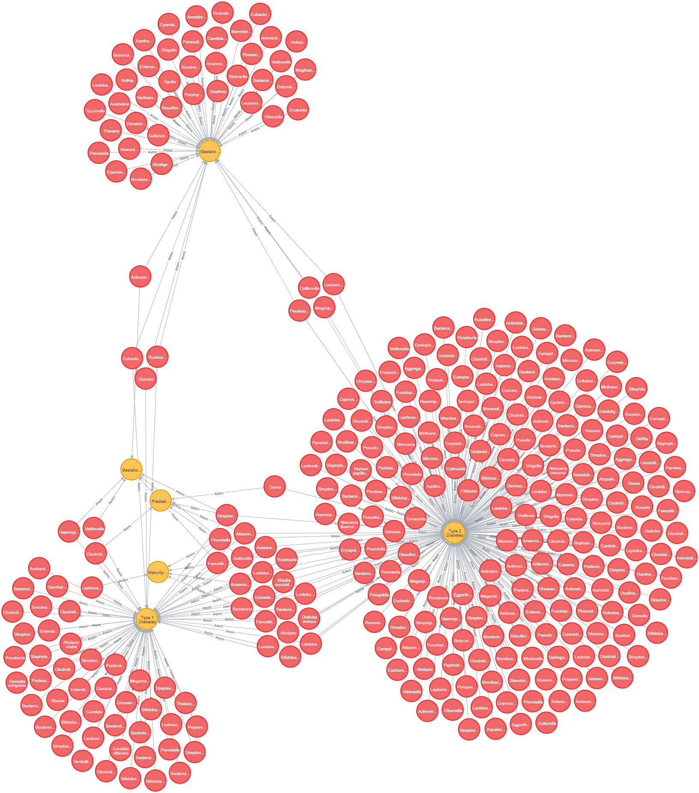
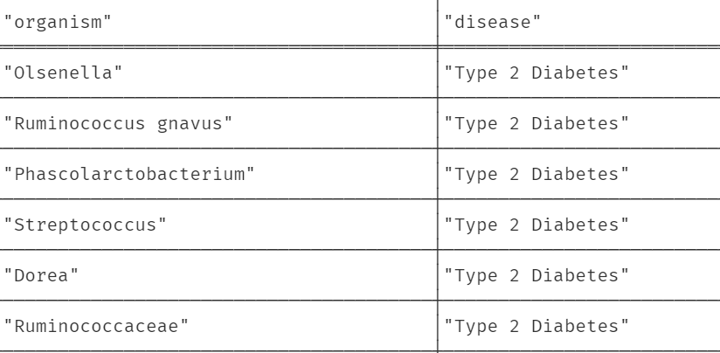

Which bacteria are linked to the different types of diabetes? Do they all share any common bacteria?
match (o:Organism)-[a:Assoc]->(d:Disease)
where d.disease =~ ".*diabetes.*" or d.disease =~".*Diabetes.*"
return o, a, d
319 nodes, 356 relationships
Notes:
Zoe

Slide 13
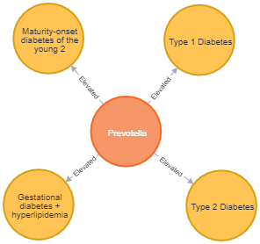
What is the greatest number of diabetes types that share common relationships with bacteria?
match (o:Organism)-[a]->(d:Disease{disease:"Type 2 Diabetes"})
match(o)-[a2]->(d2:Disease{disease:"Type 1 Diabetes"})
match(o)-[a3:Assoc]->(d3:Disease{disease:"Maturity-onset diabetes of the young 2"})
match(o)-[a4:Assoc]->(d4:Disease{disease:"Gestational diabetes + hyperlipidemia"})
return o, a, d, d2, a2, d3, a3, d4, a4
Notes:
Amanda
Prevotella - usually part of oral and gut microbiome
Missing gestational and prediabetes

Slide 14
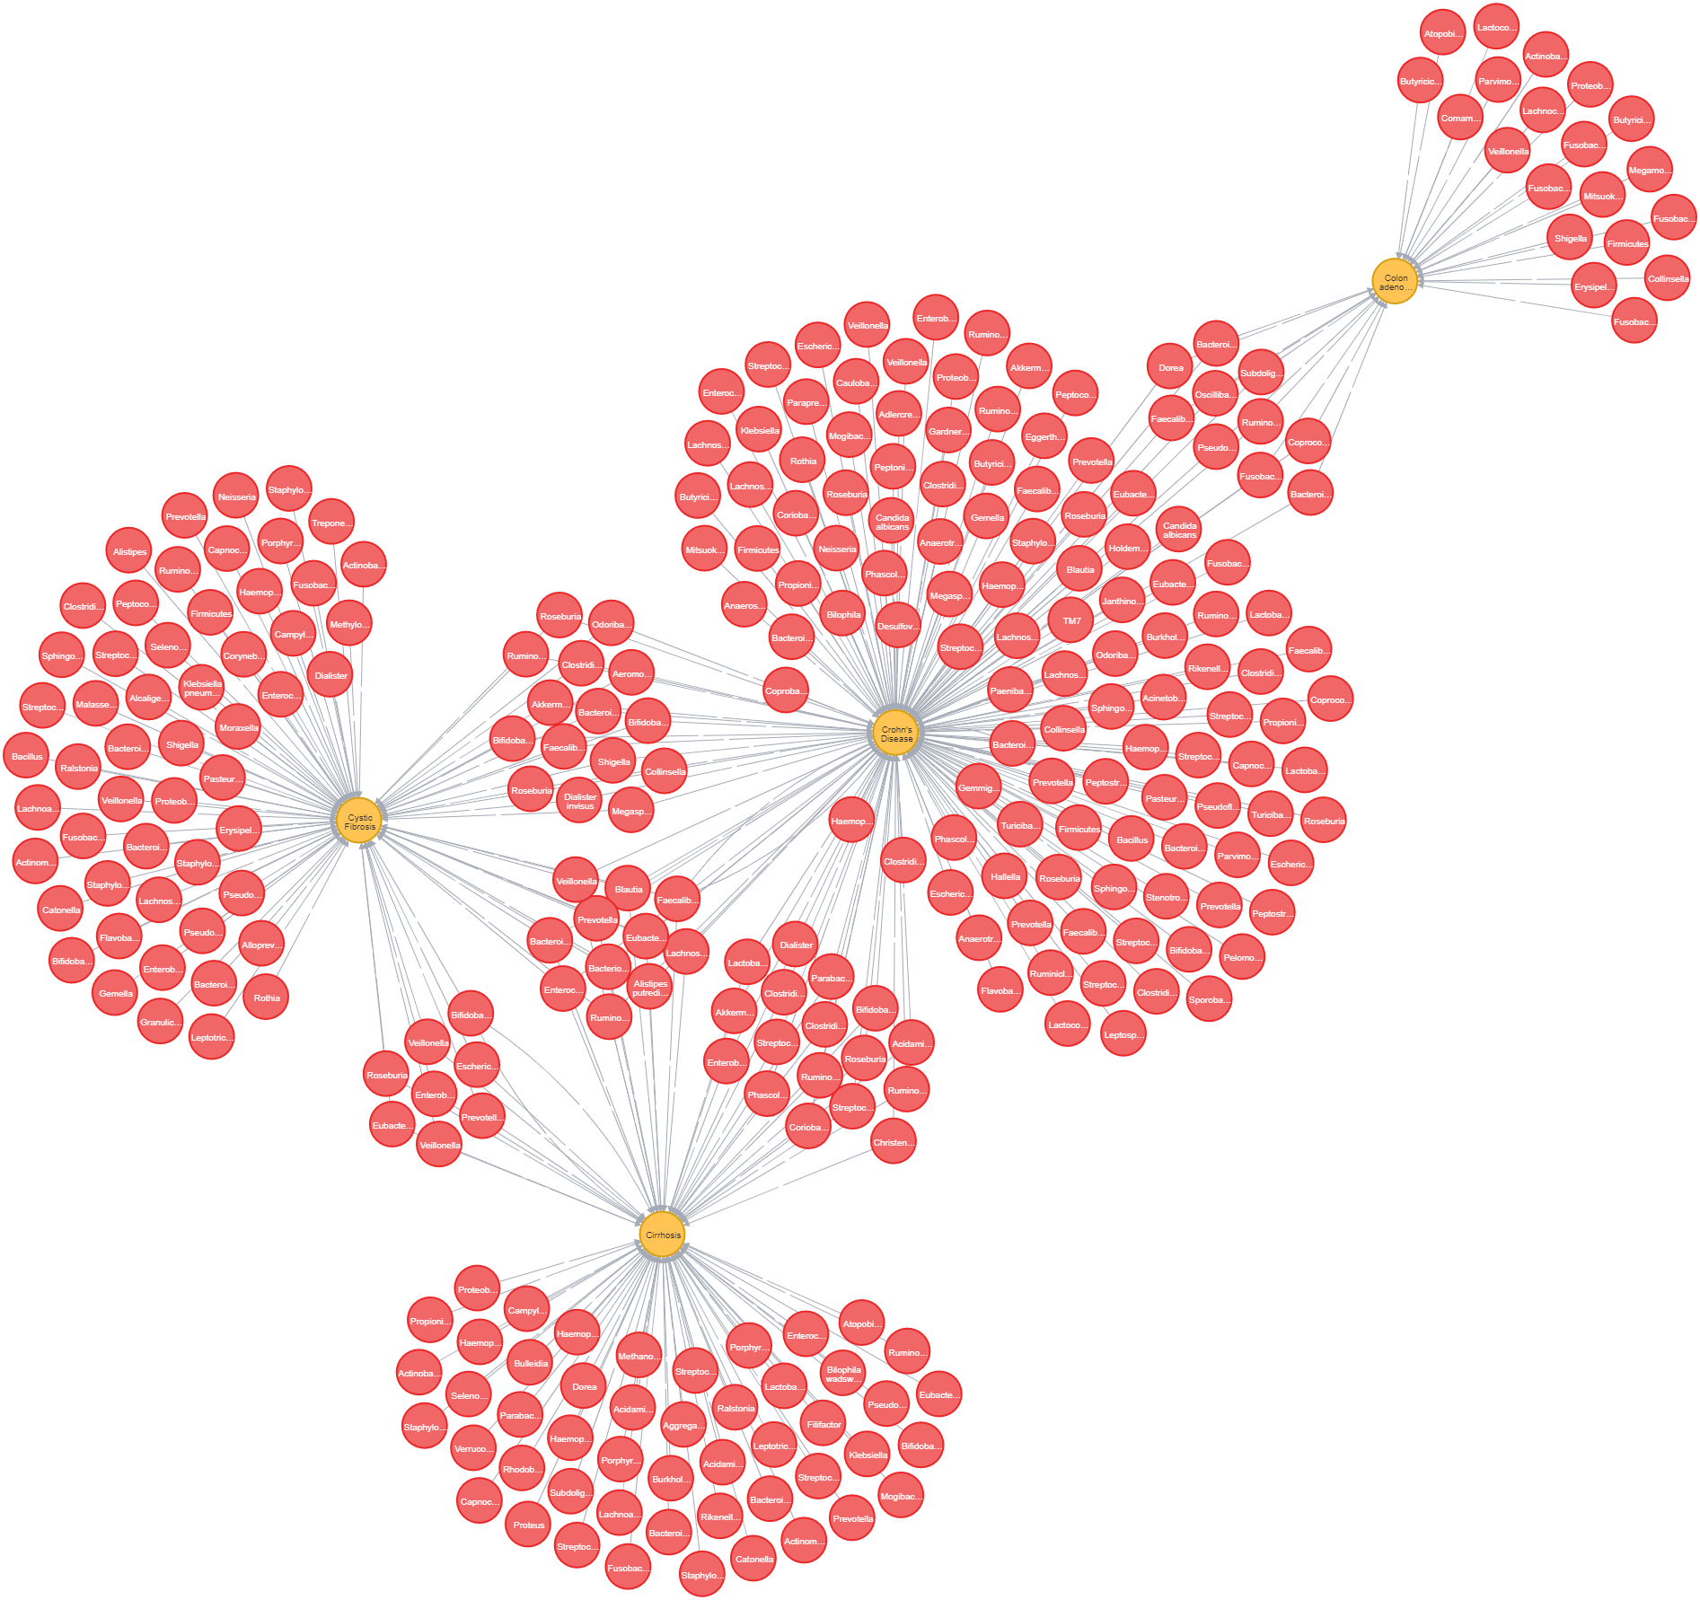
What diseases are associated with bacteria linked to cancer?
Cystic fibrosis*
Crohn’s Disease
Colon adenomas*
Cirrhosis*
call {
match (o:Organism)-[a:Assoc]->(d:Disease)
where d.disease =~ ".*cancer.*" or d.disease =~".Cancer.*"
return collect(o.organism) as bacteria
}
match (o:Organism)-[a:Assoc]->(d:Disease)
where o.organism in bacteria
return o, a, d
Notes:
vivek

Slide 15
Further Research
What microorganisms are implicated in multiple cancer types?
Neurodegenerative diseases
Look at other groups of diseases
Autoimmune, metabolic, cardiovascular, etc.
Antibiotic and antiviral targets for reducing microbiological load
Treatment to restore gut microbiome and targets for disease mitigation
Notes:
vivek

Slide 16

Thank you!
Any Questions?

